Slide 1

Acxiom data findings

Slide 2
Data Overview

Slide 3
Data is related to the US population
The data provide demographics and user behavior information
The values are dichotomous in nature i.e where each variable outcome is either “1” or “Null”
Only 1% of the total data was sampled and provided. This equaled to data on 2,487,249 individuals.
Sources for the data includes
Self reported data - example government database
Surveys
Model prediction

Slide 4
Basic Exploratory Analysis

Slide 5
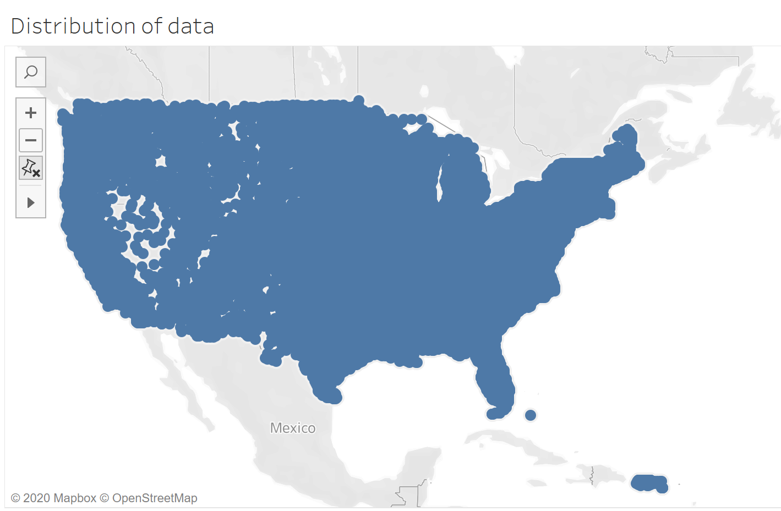
Data is well distributed across all the US states
For this analysis Zip code is used to visualize the data

Slide 6
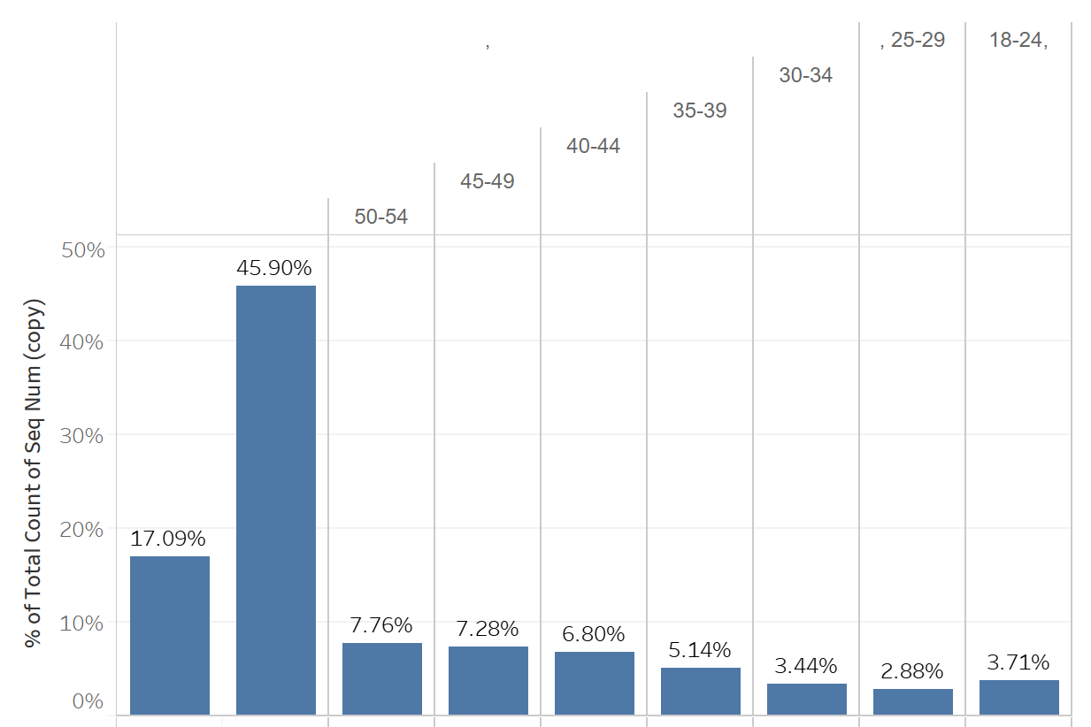
The data is skewed towards individuals - age 55+
There is also good percentage of missing data.
Missing
55+
Individuals in 5 year age interval bracket

Slide 7
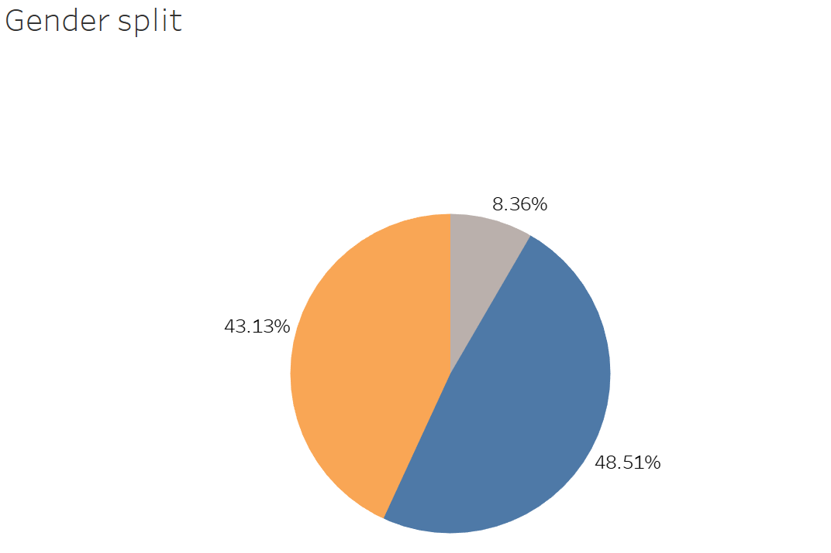
Male
Female
The data is well distributed among Male and Female gender
Again there is missing data. Something to account for in future modeling.
Missing

Slide 8
There are 10 propensity score data files.
In total 3542 variables across all the data files
Source of data is from model prediction
Context of the data includes
US Retail - Likelihood to purchase retail products
US CPG - Likelihood to purchase consumer goods and household products
US Financial - Behavior related to financial and banking activities
US Media - Behavior related to different media engagement
US lifestyle - Behavior related to lifestyle choices
US Insurance - Behavior related to insurance purchase
US Automotive - Behavior related to automobile purchase and rental
US Technology - Behavior related to tech engagement
US Telecom - Behavior related to purchases in telecom products and services.

Slide 9
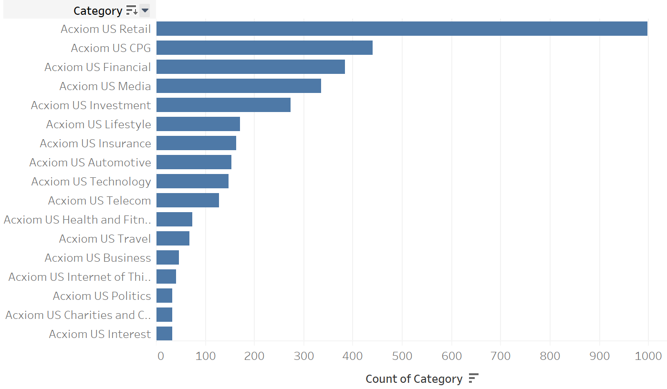
Below chart list the count of variables in each category. For example Retail has the high count of variables.

Slide 10
Findings

Slide 11
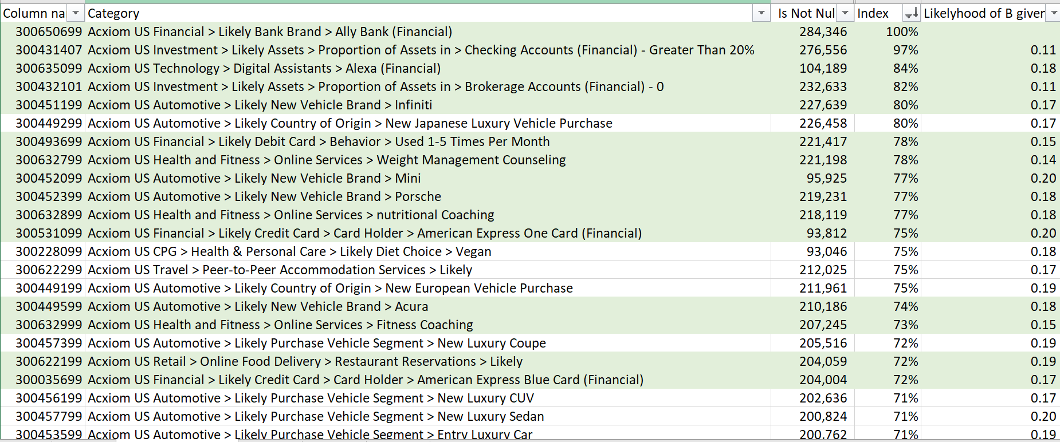
The row highlighted in green, provides some unique characteristics of Ally bank customers.

Slide 12
Below steps were carried out for this analysis
01
Data selection
For the analysis I Identified individuals that have a likelihood of being Ally Bank customers
02
Data transformation
Computed a list of variables where the value is not null and are among the top 30%. This reduced the variables from 3542 to 455.
03
Variable selection
Computed the index value for each of the variable and sorted the data in descending order.Index value is calculated using bayesian statistics
04
Identify unique signals
Eyeballed the list variables to find some unique signals.
Below google sheet will give you access to the raw data finding
https://drive.google.com/file/d/1ydRRReFJJnzrwux67LLT0BL7LcjYuGUd/view?usp=sharing

Slide 13
Next steps

Slide 14
Reduce the dimension of the data to 7 or 8 factors.
Factors were decided based on the curse of dimensionality. General rule of them is n^n rows where n = number of variables.
Use Multiple correspondence analysis algorithm to reduce the dimension
Cluster the data on the reduced data set
Get an updated version of the data
Identify if any individual migrated from one cluster to another. This can help identify behavior pattern.

